Slide 2

Are we recording?

Slide 3
AI-Powered Text Generation Portal
October 7th, 2025

Slide 4
How was Assignment 2 ?
Notes:
Did anyone do the extra credit?

Slide 5

Overview of key concepts
Overview of assignment

Slide 6
What is the actual process for building these systems?
Web scraping (data collection)
Clean and preprocess the data
Text Representation (converting words to something numeric the computer can understand)
Pick a model -> Train the model -> Tune parameters -> Retrain the model (iterate)
Confirm results

Slide 7


Neural Networks
A neural network is a machine learning model that stacks simple "neurons" in layers and learns pattern-recognizing weights and biases from data to map inputs to outputs.
Mini calculators

Slide 8
Language Models
Language models in AI are statistical / ML models trained on vast amounts of text data to understand, generate, and manipulate human language.
They work by predicting the most probable next word in a sequence
Useful for performing tasks like text generation, translation, summarization, and answering questions
Today's most advanced language models, like Large Language Models (LLMs), are built on deep neural networks with multiple layers.
LARGE Language Models - Trained on billions of parameters & massive training data

Slide 9
GPT
G - Generative : Model that generates text
P - Pretrained : Pretrained on textual data
T – Transformer : A type of architecture of Neural Networks
Transformers can understand text much better than older systems because they notice all the connections between words, no matter where the words are.
Essentially this model tries to generate the next token

Slide 10
Training Loss
Training Loss is a number that measures how “off” the model’s guesses are compared to the real answers.
A high loss means the model is making more mistakes; a low loss means it’s getting better. The goal of training is to make this loss number as small as possible.
Our goal is to minimize this training loss over time.
Loss in GPT - GPT model tries to guess the next word (or token) in a sentence, and training loss measures how far off these guesses are from the real next word that should appear.

Slide 11
Training Loop
In a single loop of training the model -
Pick a batch of examples from the training text.
Make predictions: The model tries to guess the next token (word or piece of a word) for each example.
Measure error (Loss): It checks how close its guesses are to the real next tokens.
Learn from mistakes: It tweaks its internal settings (called weights) so it can do better next time.
Repeat 1 to 4 thousands or millions of times

Slide 12
Training Loop
In a single loop of training the model -
Pick a batch of examples from the training text.
Make predictions: The model tries to guess the next token (word or piece of a word) for each example.
Measure error (Loss): It checks how close its guesses are to the real next tokens.
Learn from mistakes: It tweaks its internal settings (called weights) so it can do better next time.
Repeat 1 to 4 thousands or millions of times

Slide 13
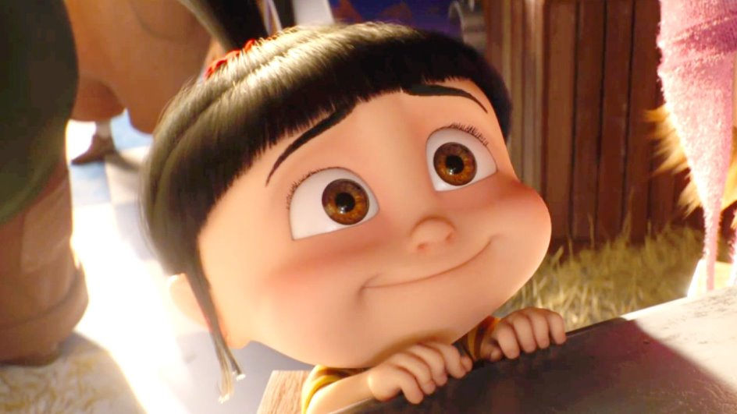
Questions?

Slide 14
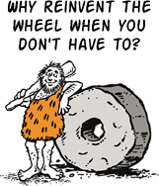

Slide 15
Assignment for weeks 4, 5, 6
Andrej Karpathy's nanoGPT
This is the main part of the project
This will span over the next three weeks and is the "AI powered" part of this project
These are the broad splits of the assignment
prepare.py that creates tokens from your input text
train.py that trains creates and trains your model
sample.py that when run will generate the "new" text
Final goal is to run this on your cleaned / processed dataset from assignment 2

Slide 16
This week's section
We'll first run the given code on the shakespeare dataset
Clone the repository and keep this directory separate from the directory you've been using so far for the last two assignments
Make sure to initialize this directory as uv environment using uv init so you can all required packages

Slide 17
This week's section (cont.)
In your project first add all the required packages
uv add torch
uv add numpy
uv add transformers
uv add datasets
uv add tiktoken
uv add wandb
uv add tqdm
Carefully install torch and numpy, if you have a macbook, install torch 2.2.2 and numpy 1.26.4 specifically cause torch's latest versions have some issue on macbooks

Slide 18
This week's section (cont.)
First you need to tokenize the shakespeare dataset
python data/shakespeare_char/prepare.py
Next you need to create and train the model
python train.py config/train_shakespeare_char.py --device=cpu --compile=False --eval_iters=20 --log_interval=1 --block_size=64 --batch_size=12 --n_layer=4 --n_head=4 --n_embd=128 --max_iters=2000 --lr_decay_iters=2000 --dropout=0.0
The training should take about 3 to 4 minutes

Slide 19
This week's section (cont.)
Notice what is being printed
What is happening to the loss? Is it going up, down, staying constant, or none of the above?
Observe these values and how they depend on our parameters.
What happens when you increase the number of iterations?
What happens when you increase the number of layers?
What about number of embeddings?
What about eval_iters (number of iterations)?
No need for anything fancy – just observe and note it down in a file! :)

Slide 20
Brief note on Google colab
Look up colab and login through your google account.
Useful cause it lets you use google compute and other resources on the cloud to train models on large datasets which can be pretty resource intensive, something normal computers can't do.
Let's you sequentially run snippets of code so it's easier and faster to debug
If you have already done one section that's time consuming and know that there are no bugs in it, you avoid re-running that by just running the next snippet that actually has the bug.

Slide 21
Questions?

Slide 22


